Slide 1
Cornerstone City Church Peninsula Plus Community Hoo Are Ya
16th March 2025

Slide 2


Slide 5
Hosanna (Praise Is Rising)
CCLI Song # 4662491
Brenton Brown | Paul Baloche
© 2005, 2006 Integrity's Hosanna! Music (Admin. by Integrity Music Ltd)
Thankyou Music (Admin. by Integrity Music Ltd)
For use solely with the SongSelect® Terms of Use. All rights reserved. www.ccli.com
CCLI Licence No. 33265

Slide 6
1/6
Praise is rising
Eyes are turning to You
We turn to You
Hope is stirring
Hearts are yearning for You
We long for You

Slide 7
2/6
‘Cause when we see You
We find strength to face the day
In Your presence
All our fears are washed away
(Washed away)

Slide 8
3/6
Hosanna Hosanna
You are the God who saves us
Worthy of all our praises
Hosanna Hosanna
Come have Your way among us
We welcome You here Lord Jesus

Slide 9
4/6
Hear the sound of
Hearts returning to You
We turn to You
In Your Kingdom
Broken lives are made new
You make us new

Slide 10
5/6
‘Cause when we see You
We find strength to face the day
In Your presence
All our fears are washed away
(Washed away)

Slide 11
6/6
Hosanna Hosanna
You are the God who saves us
Worthy of all our praises
Hosanna Hosanna
Come have Your way among us
We welcome You here Lord Jesus

Slide 12
House Of The Lord
CCLI Song # 7168995
© 2020 Phil Wickham MusicSimply Global SongsBe Essential SongsCashagamble Jet Music
For use solely with the SongSelect® Terms of Use. All rights reserved. www.ccli.com
Note: Reproduction of this sheet music requires a CCLI Music Reproduction Licence. Please report all copies.
CCLI Licence No. 33265

Slide 13
1/9
We worship the God who was
We worship the God who is
We worship the God who evermore will be
He opened the prison doors
He parted the raging sea
My God He holds the victory yeah

Slide 14
2/9
There’s joy in the house of the Lord
There’s joy in the house of the Lord today
And we won’t be quiet
We shout out Your praise

Slide 15
3/9
There’s joy in the house of the Lord
Our God is surely in this place
And we won’t be quiet
We shout out Your praise

Slide 16
4/9
We sing to the God who heals
We sing to the God who saves
We sing to the God who always makes a way
'Cause He hung up on that cross
Then He rose up from that grave
My God’s still rolling stones away

Slide 17
5/9
There’s joy in the house of the Lord
There’s joy in the house of the Lord today
And we won’t be quiet
We shout out Your praise

Slide 18
6/9
There’s joy in the house of the Lord
Our God is surely in this place
And we won’t be quiet
We shout out Your praise

Slide 19
7/9
We were the beggars
Now we’re royalty
We were the prisoners
Now we’re running free
We are forgiven accepted
Redeemed by His grace
Let the house of the Lord sing praise
(REPEAT)

Slide 20
8/9
There’s joy in the house of the Lord
There’s joy in the house of the Lord today
And we won’t be quiet
We shout out Your praise

Slide 21
9/9
There’s joy in the house of the Lord
Our God is surely in this place
And we won’t be quiet
We shout out Your praise

Slide 23
Spirit Break Out CCLI Song # 6058450
Ben Bryant | Luke Hellebronth | Myles Dhillon | Tim Hughes
© 2010 Thankyou Music (Admin. by Integrity Music)
For use solely with the SongSelect® Terms of Use. All rights reserved. www.ccli.com
CCLI Licence No. 33265

Slide 24
1/4
Our Father all of heaven roars Your name Sing louder let this place erupt with praise Can you hear it the sound of heaven touching earth The sound of heaven touching earth

Slide 25
2/4
Spirit break out Break our walls down Spirit break out Heaven come down

Slide 26
3/4
King Jesus You're the name we're lifting high Your glory shaking up the earth and skies Revival we want to see Your kingdom here We want to see Your kingdom here

Slide 27
4/4
Spirit break out Break our walls down Spirit break out Heaven come down

Slide 28
Hosanna CCLI Song # 4785835
Brooke Ligertwood
© 2006 Hillsong Music Publishing Australia
For use solely with the SongSelect® Terms of Use. All rights reserved. www.ccli.com
CCLI Licence No. 33265

Slide 29
1/8
I see the King of glory
Coming on the clouds with fire
The whole earth shakes
The whole earth shakes yeah

Slide 30
2/8
I see His love and mercy
Washing over all our sin
The people sing
The people sing

Slide 31
3/8
Hosanna hosanna
Hosanna in the highest
Hosanna hosanna
Hosanna in the highest

Slide 32
4/8
I see a generation
Rising up to take their place
With selfless faith
With selfless faith

Slide 33
5/8
I see a near revival
Stirring as we pray and seek
We're on our knees
We're on our knees

Slide 34
6/8
Hosanna hosanna
Hosanna in the highest
Hosanna hosanna
Hosanna in the highest

Slide 35
7/8
Heal my heart and make it clean
Open up my eyes to the things unseen
Show me how to love like You have loved me
Break my heart for what breaks Yours
Everything I am for Your Kingdom's cause
As I walk from earth into eternity

Slide 36
8/8
Hosanna hosanna
Hosanna in the highest
Hosanna hosanna
Hosanna in the highest

Slide 37
Revelation Song
CCLI Song # 4447960
Jennie Lee Riddle
© 2004 Gateway Create Publishing (Admin. by Integrity Music Ltd)
For use solely with the SongSelect® Terms of Use. All rights reserved. www.ccli.com
CCLI Licence No. 33265

Slide 38
1/4
Worthy is the Lamb Who was slain
Holy holy is He
Sing a new song to Him Who sits on
Heaven's mercy seat

Slide 39
2/4
Holy, Holy, Holy
Is the Lord God Almighty
Who was and is and is to come
With all creation I sing
Praise to the King of kings
You are my ev'rything
And I will adore You

Slide 40
3/4
Clothed in rainbows of living colour
Flashes of lightning rolls of thunder
Blessing and honour strength and Glory and power be
To You the only wise King

Slide 41
4/4
Filled with wonder awestruck wonder
At the mention of Your name
Jesus Your name is power breath and living water
Such a marvelous mystery

Slide 43


Slide 44


Slide 45
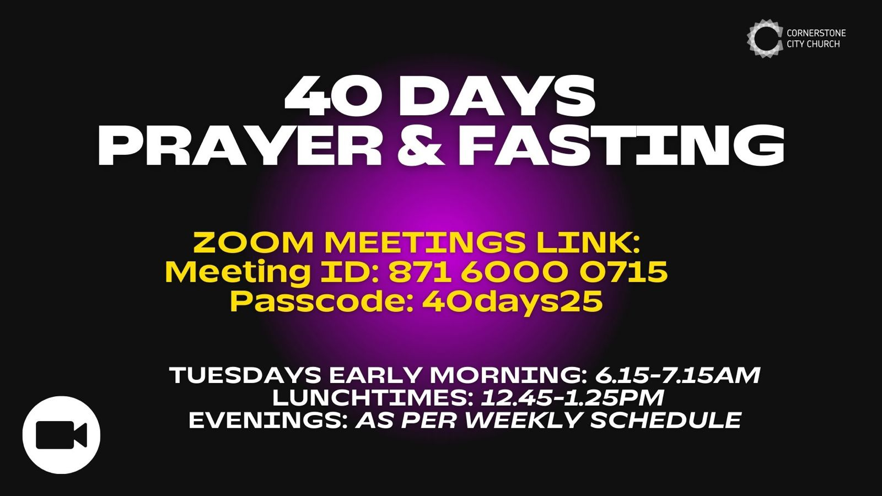

Slide 46
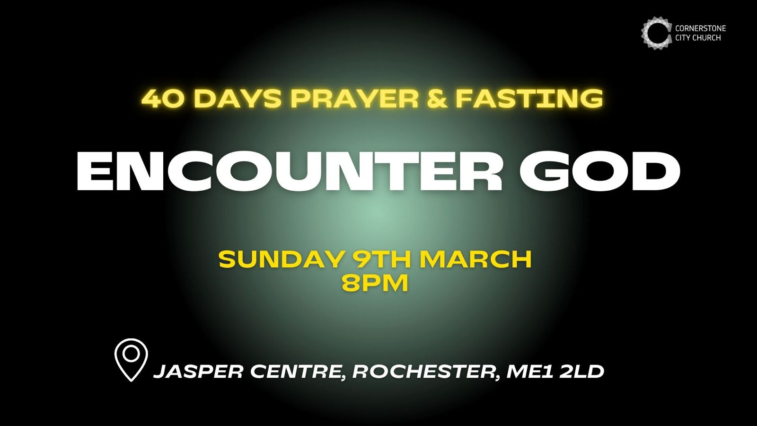

Slide 47


Slide 48
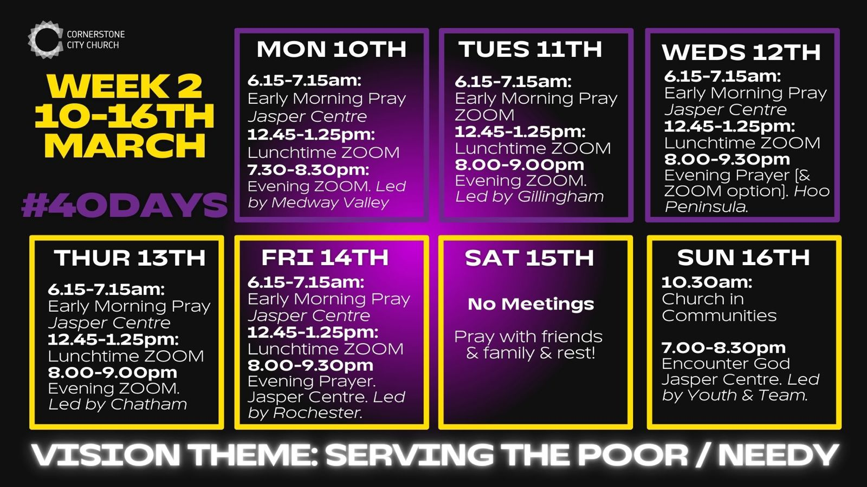

Slide 49
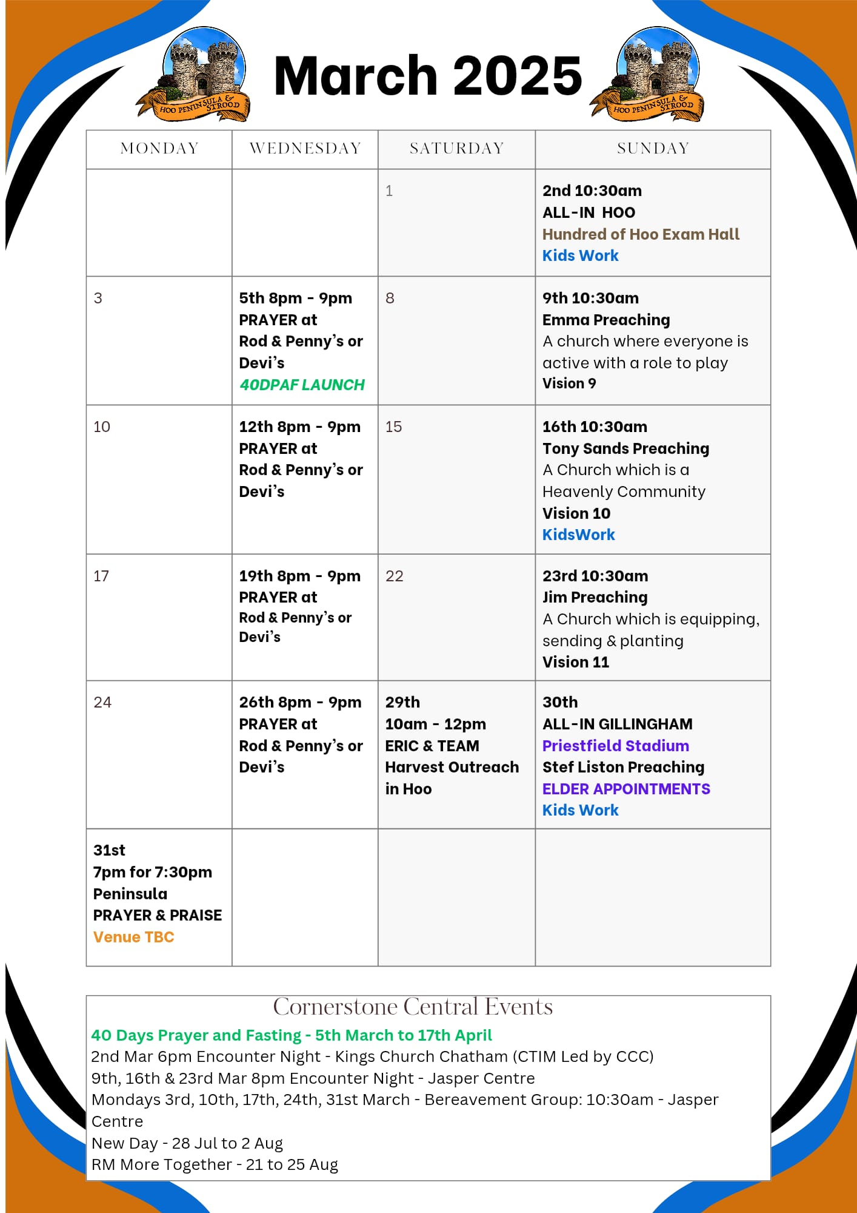

Slide 50

Grow Group 1
Grow Group 1 Name: On YOUR MARK!

Slide 51
Leaders
Leaderss
Phil & Kim
Maria (Mia) Warren
Matthew Harrison
Richard & Elisha Acheampong
Phil & Kim
Maria (Mia) Warren
Matthew Harrison
Richard & Elisa Acheampong

Slide 52
Q1 into Q2 Meeting Dates
Q1 into Q2 Meeting Dates
Month | Date / Day | Host
January | Saturday 11th | Maria
 | Wednesday 22nd | Maria
February | Saturday 8th | Venue Needed
 | Wednesday 19th | Phil & Kim
March | Saturday 8th | Richard & Elisha
 | Wednesday 19th | Venue Needed
April | Saturday 12th | Matt
 | Wednesday 30th | Venue Needed

Slide 53

Storm Walker
Storm Walker
Symbolising, trust in Jesus Christ through life's storms.
Mark 4:35-41

Slide 54



Group Leaders
Micheal and Mwamba
Wilfred and Parveen
Hannah

Slide 55
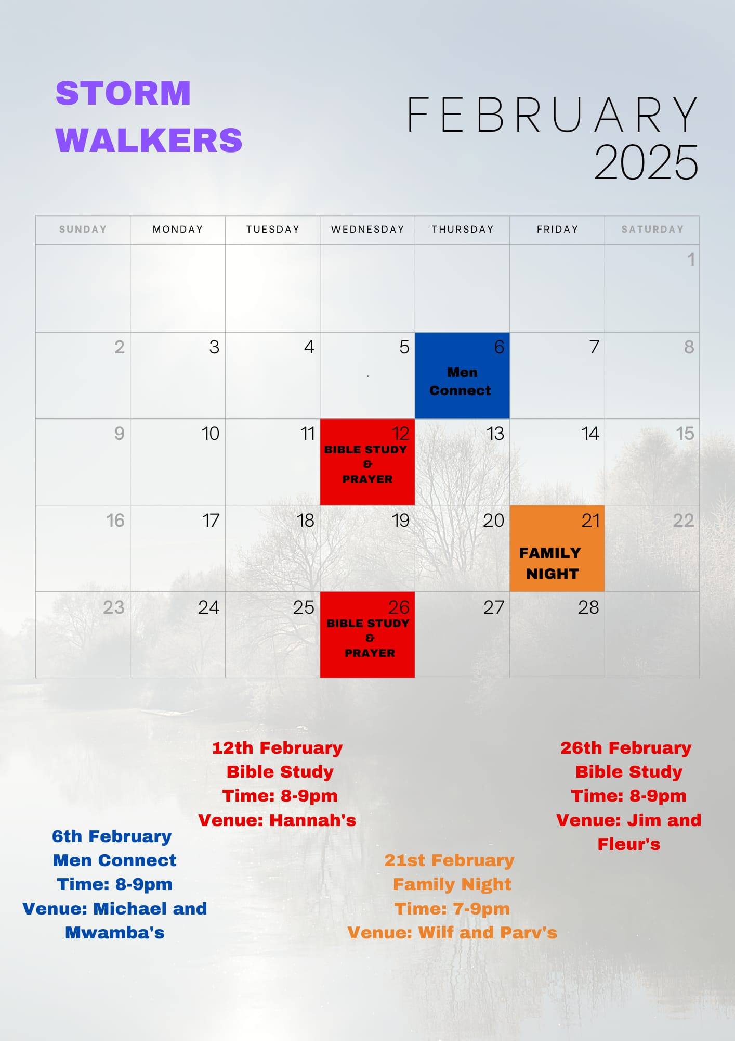

Slide 56


Slide 57
2 Corinthians 14 May the grace of the Lord Jesus Christ, and the love of God, and the fellowship of the Holy Spirit be with you all
Surely goodness and mercy shall follow me all the days of my life, and I shall dwell in the house of the Lord forever.

